Slide 1
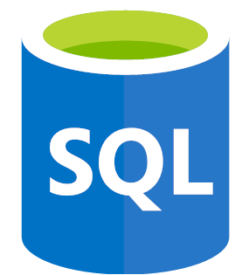
Complete SQL and Database Bootcamp: Zero to Mastery
Section 2
History and Story of Data

Slide 2
Complete SQL and Database Bootcamp: Zero to Mastery
History & Story of Data
Section: 2.6, 2.7, 2.8
Date: 11/01/22
A database is a logically modeled cluster of information [data] that is typically stored on a computer or other type of hardware that is easily accessible in various ways.
A database management system is a computer program or other piece of software that allows one to access, interact with, and manipulate a database.
Terms
DBMS: database management system – it’s a computer program or piece of software used to manage a database, it receives instruction from a user and performs an action on a database.
RDBMS: relational database management system – it’s a DBMS but on a relational database, which is the most common and popular type of database. RDBMS's include the Amazon RDS, Oracle, and MySQL, PostgreSQL which all utilize Structured Query Language (SQL) to manipulate the different databases they interact with.
SQL: structured query language, it’s a way for us to interact with a database management system. The beauty is it works and can interact with a lot of databases.
https://www.exactdata.net/data-blog/databases-vs-database-management-systems

Slide 3
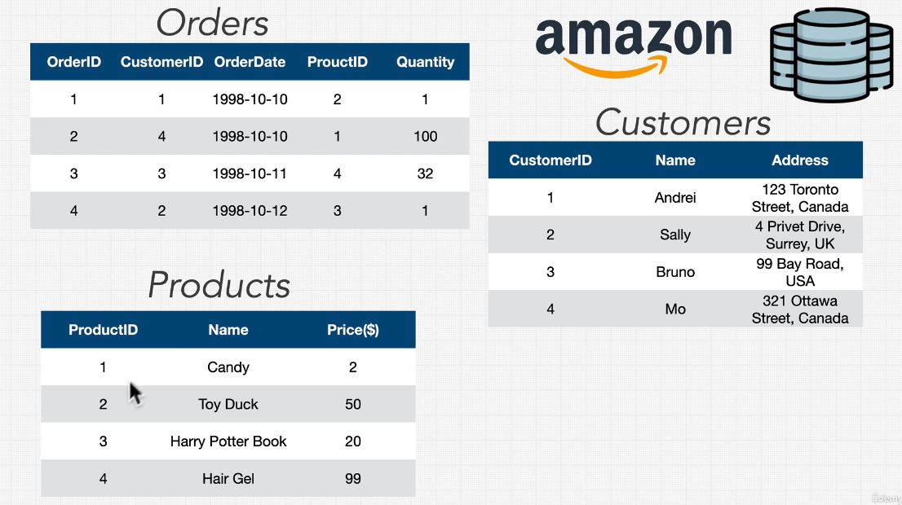
Complete SQL and Database Bootcamp: Zero to Mastery
History & Story of Data
Section: 2.9, 2.10
Date: 11/01/22
Relational Database Example
An example of a relational database is shown in the figure below. Here on our ‘Orders’ table we have columns which refer to information in other tables. Customer ID in the orders table is useless without the Customers table which provides information on the name, address etc of each ID.

Slide 4
Complete SQL and Database Bootcamp: Zero to Mastery
History & Story of Data
Section: 2.11
Date: 11/01/22
Types of Databases (or Database Models)
Relational (e.g. mySQL) we’ve just seen an example of this, they support something called asset transactions. Often used with customers or users.
Document (e.g. mongoDB) instead of lots of tables, rows and columns, instead data is stored more in a document format with each document holding lots of data inside. Highly scalable.
Key Value (e.g. dynamoDB, redis) simplest form of database where you provide a key and a value is returned, functions like a python dictionary
Graph (e.g. AWS Neptune) much rarer, more complex and very specific. Useful for highly relational data.
Wide Columnar (e.g. Apache Cassandra) fairly new, pioneered by google.

Slide 5
Complete SQL and Database Bootcamp: Zero to Mastery
Section 3
Databases and SQL Fundamentals

Slide 6
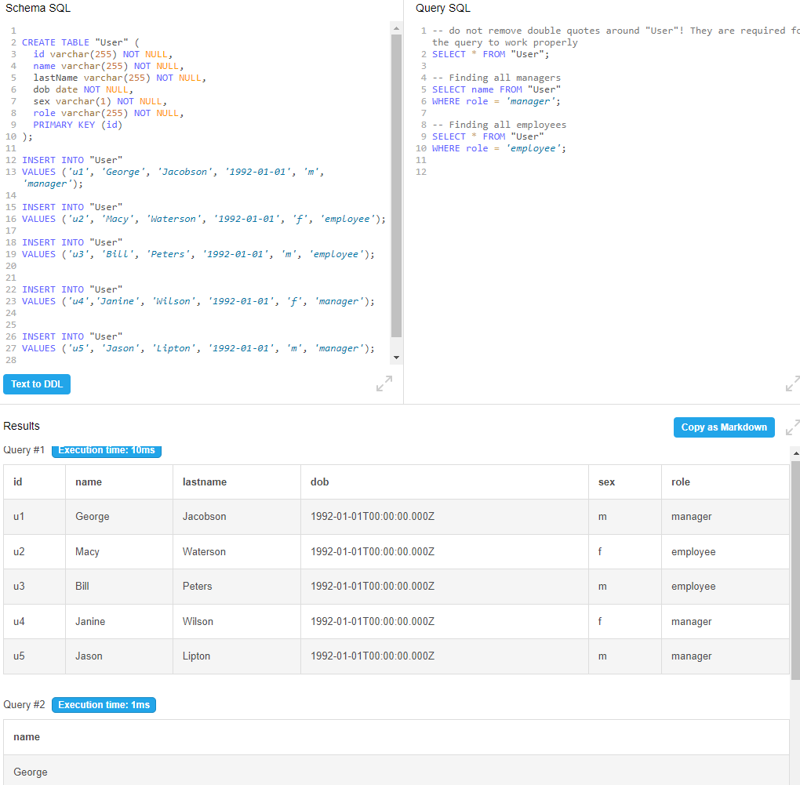
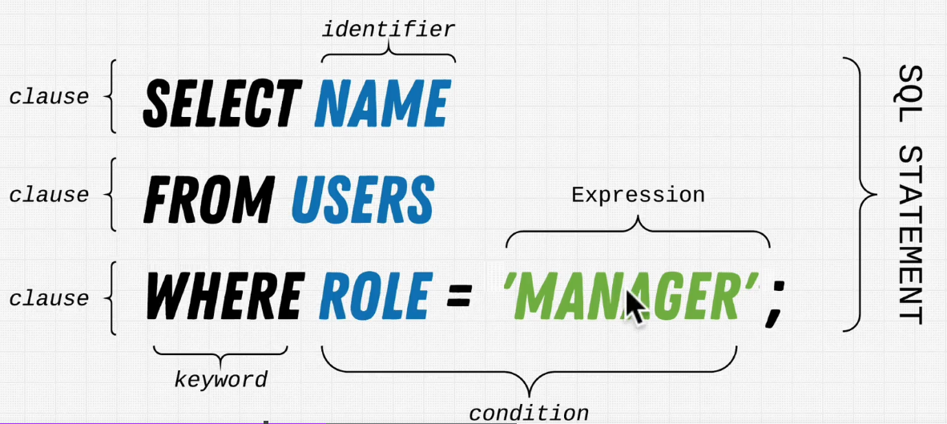
Complete SQL and Database Bootcamp: Zero to Mastery
Databases and SQL Fundamentals
Section: 3.16, 3.17
Date: 11/01/22
Example to the right shows the formation of a database with a table called ‘User’, along with a few basic SQL queries that return all the data as well as some more reduced queries just looking for specific data dependant on role (employee vs manager).
Note that often all keywords are placed in capitals in SQL.
https://www.db-fiddle.com/f/ogAiTgZPjwvDxwVHiVK3Ek/530
https://stackoverflow.com/questions/292026/is-there-a-good-reason-to-use-upper-case-for-sql-keywords

Slide 7
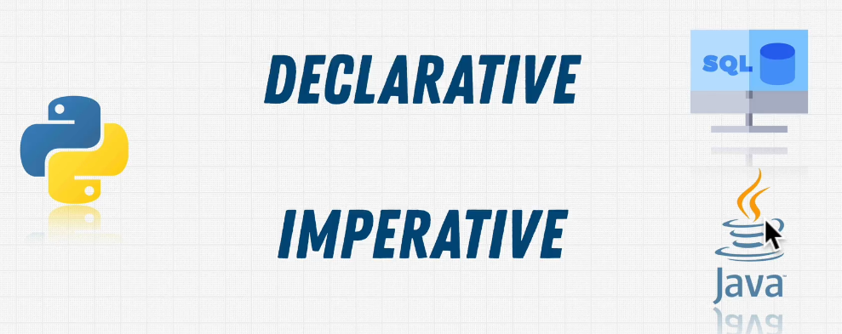
Complete SQL and Database Bootcamp: Zero to Mastery
Databases and SQL Fundamentals
Section: 3.18
Date: 11/01/22
Declarative vs Imperative Programming
In declarative we say what will happen, but do not define how to achieve this. This is SQL, we say we want all the data on managers in a ‘User’ table using SELECT * FROM ‘User’ WHERE role = ‘manager’. We do not specify to SQL how to perform this task we simply state what we would like.
In imperative programming (e.g. Java), we must state how to achieve something. Therefore we might need to tell the program where to read from a hard drive. In python we can do both declarative and imperative.
Declarative is powerful because of its simplicity. Imperative on the other hand is far more flexible.

Slide 8
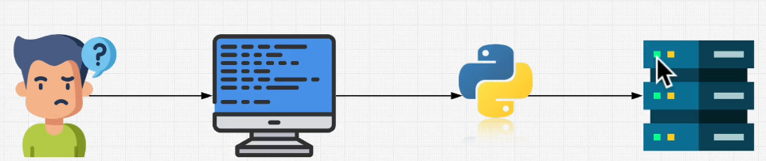
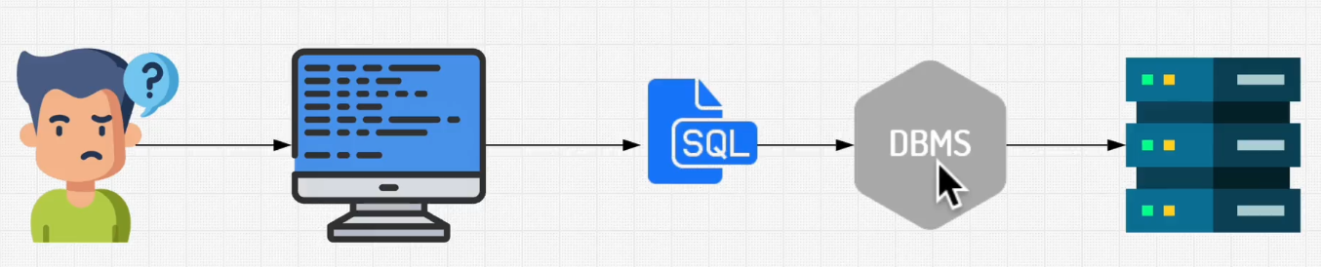
Complete SQL and Database Bootcamp: Zero to Mastery
Databases and SQL Fundamentals
Section: 3.19, 3.23, 3.24
Date: 12/01/22
History of SQL
SQL or Sequel? Originally it was called Sequel and stood for structured English query language, but had to change its name due to copywrite conflict. So now its simply structured query language.
Originally developed by IBM in the 1980s.
Previously we didn’t have relational databases. Instead there were file processing systems. These worked ok but they had limitations because each store could not talk to another. Therefore, often data would be duplicated. If the address of someone changed, it would need to be changed in many databases. It also meant the user needed to know a lot more about the data and where it was stored because the code you were writing would need to interact directly with the database.
Since then the industry has adopted SQL and database management systems. Now a user expresses they want through SQL which through a DBMS performs an action on the database (e.g. extract data).
Previously with File Processing Systems
(may not necessarily be using python, could be Java etc.)
Now with SQL and Database Management Systems
(User only needs to know SQL in order to interact with a database)

Slide 9
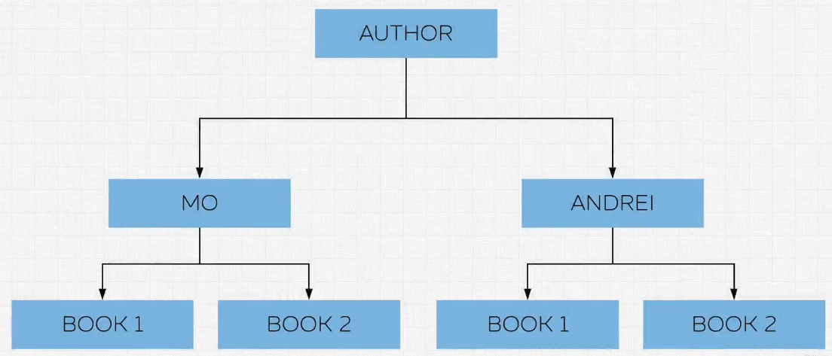
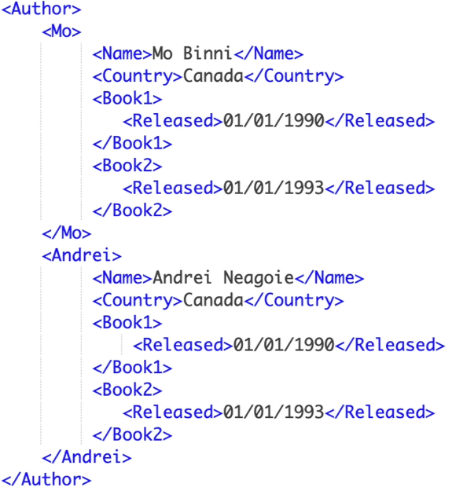
Complete SQL and Database Bootcamp: Zero to Mastery
Databases and SQL Fundamentals
Section: 3.27
Date: 12/01/22
Hierarchical Model
Predominantly used by IBM in the 60’s and 70’s. Previously all data was effectively formed into lists and to find the data you were interested in, you needed to search through from top to bottom. Hierarchical models allowed you to more quickly find you data through searching down a tree, see an example below, where’s books are split by author (tree figure on the left, and similar data in XML format on the right). There are some limitations however. Each node/child can only have a single root, meaning both Mo and Andrei could not co-author a book together in this example. It is good however, for describing data that is a ‘one to many’ relationship. Note this is similar to a nested dictionary.

Slide 10
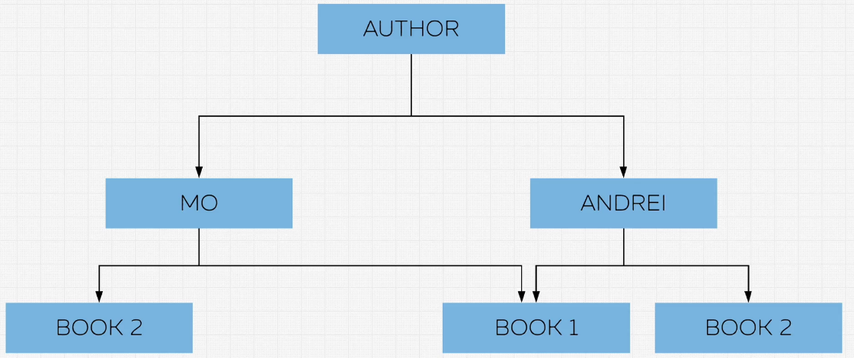
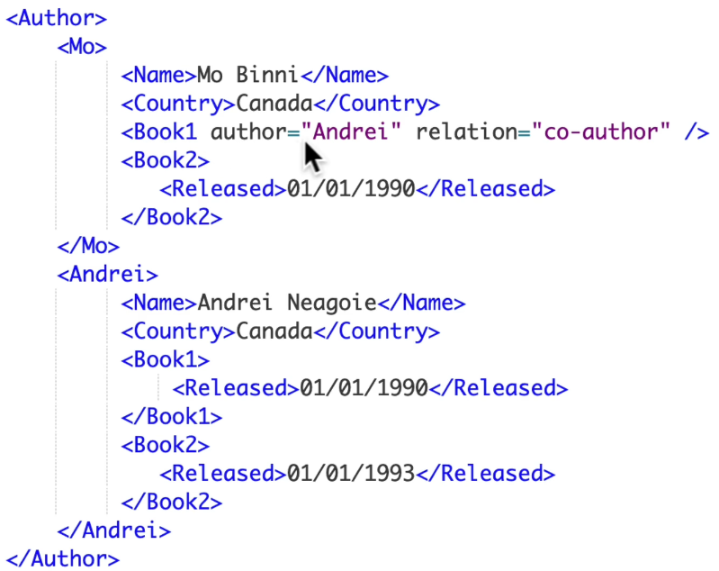
Complete SQL and Database Bootcamp: Zero to Mastery
Databases and SQL Fundamentals
Section: 3.27
Date: 12/01/22
Networking Model
This expanded on the hierarchical model, allowing many to many relationships. A child node could no longer only have one parent node. In order to do this, we would have a child node with a parent node tree, but it would reference another parent node. See an example of how this is might be achieved in the XML to the bottom right. Book 1 information is stored under Andrei, but is referenced under Mo. This doesn’t come without problems/inefficiencies though. Say if book 1 under Andrei was deleted. We would need to go though all the data to see if there was a reference to this that should also be deleted.

Slide 11
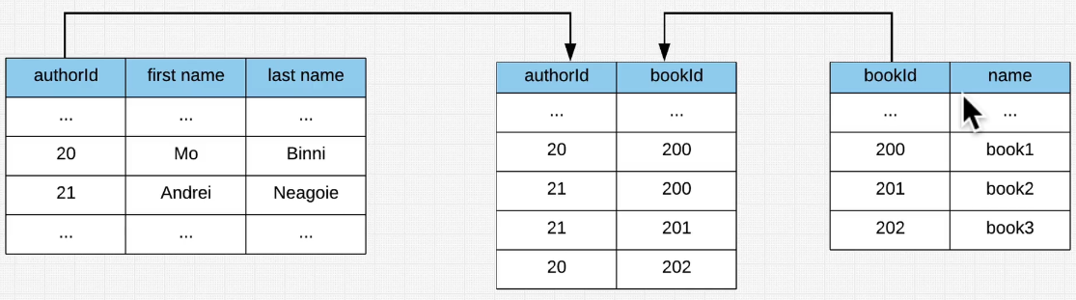
Complete SQL and Database Bootcamp: Zero to Mastery
Databases and SQL Fundamentals
Section: 3.28
Date: 12/01/22
Relational Model
First model with a formalised set of rules. This followed organising your data in tables. Another example of relational database is shown below. We can see how in this case we’re using an author ID and a book ID to connect data from different tables together.
We could do this in excel, but excel wouldn’t know how they were linked unless we specified this in some way (maybe with a lookup function). The logic of how the data and tables are linked is managed by the database management system (DBMS).

Slide 12
Complete SQL and Database Bootcamp: Zero to Mastery
Databases and SQL Fundamentals
Section: 3.29
Date: 12/01/22
Database Management System
The DBMS knows all the rules about how you want to store you’re data, and when provided with an SQL query, knows how to access the data and how to delivery it. It can:
C - Create
R - Read
U - Update
D – Delete
It will also ensure the data is stored in the right location and is secure, maybe through encryption. It will also have a transaction management, which handles instances where updates are made at the same time or data conflicts.
The biggest companies that make DBMS are Microsoft (SQL Server), IBM, MySQL Oracle etc. PostreSQL (often referred to simply as Postgres) is an open source version. They all make it slightly different with different associated features. Some may follow the relational model, some may follow the hierarchical model. The key thing is, most will allow us to use SQL to communicate with our database.

Slide 13
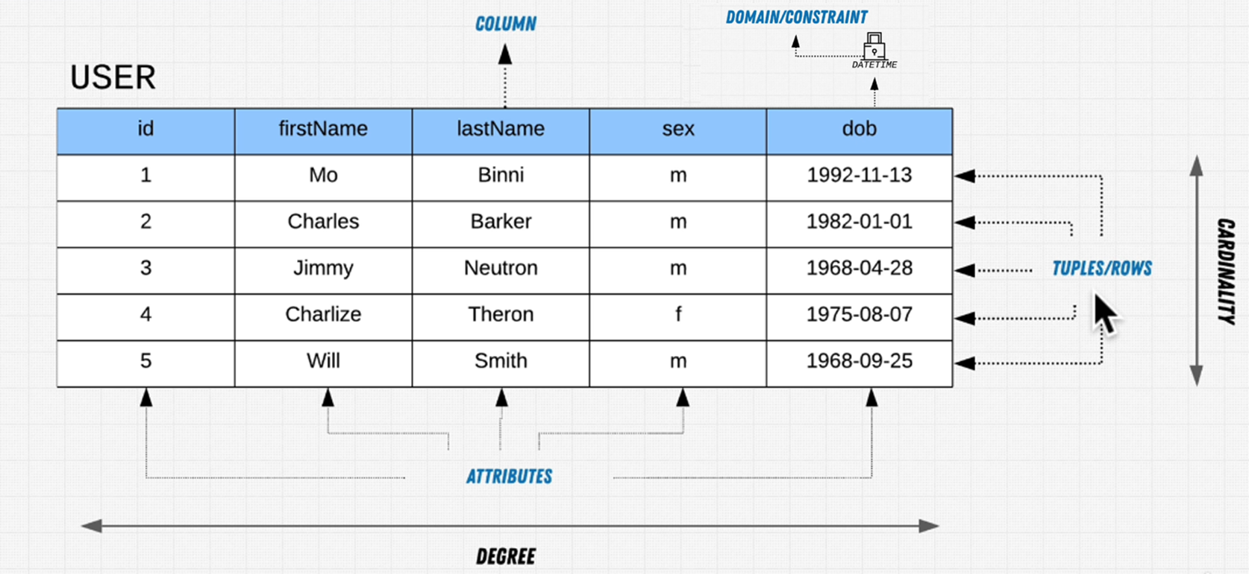
Complete SQL and Database Bootcamp: Zero to Mastery
Databases and SQL Fundamentals
Section: 3.31, 3.32, 3.33
Date: 12/01/22
Relational Model Terms
Tables – Each table or relation has a name and relates to the concept of the data we wish to store in it e.g. user. We’ve already seen we can use the name of a table to narrow down our query with the SELECT keyword. We’re quite specific with what we want to store in a table, each data entry will need to satisfy all columns otherwise we will have blank points.
Columns – The collection of columns is called the degree. Say in the user table or relation, we could have a degree of ID, name and DoB. We can also specify constraints on data that can be entered into a given column. For example we may set datetime as a domain or constraint to the DoB column. A single column could also be called an attribute.
Rows – Rows are otherwise known as tuples. Tuple is a single record of data, similar to a python tuple which is effectively an immutable list. The collection of rows or tuples is also called the cardinality.

Slide 14
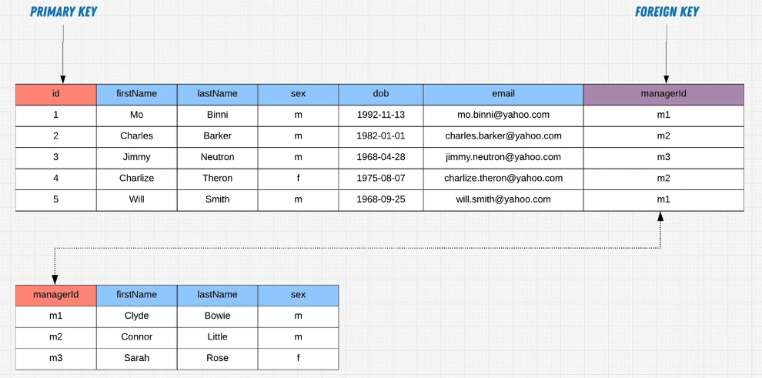
Complete SQL and Database Bootcamp: Zero to Mastery
Databases and SQL Fundamentals
Section: 3.34
Date: 12/01/22
Relational Model Terms
Primary Key – This uniquely identifies all data for a single row/tuple in a single table. No single ID in the primary ID column will be replicated in that table.
Foreign Key – This is a reference to another table. It does not need to be unique. We can see that in the figure below where we see multiple m1 and m2 keys. This is fine though because this is referencing a primary key in another table.

Slide 15
Complete SQL and Database Bootcamp: Zero to Mastery
Databases and SQL Fundamentals
Section: 3.34
Date: 12/01/22
Relational Model Terms
Primary Key – This uniquely identifies all data for a single row/tuple in a single table. No single ID in the primary ID column will be replicated in that table.
Foreign Key – This is a reference to another table. It does not need to be unique. We can see that in the figure below where we see multiple m1 and m2 keys. This is fine though because this is referencing a primary key in another table.

Slide 16
Complete SQL and Database Bootcamp: Zero to Mastery
Databases and SQL Fundamentals
Section: 3.35
Date: 12/01/22
Supporting Day to Day – OLTP (Online Transaction Processing) – These are databases that are managing the engine of a company, like the users, the orders, stock etc.
Support Analysis – OLAP (Online Analytical Processing) – This is where you take the data from the day to day part the OLTP part, you put it into a data warehouse and then you perform all type of analytics on it, machine learning on it, to progress the business, understand the users, understand what can be done to make the business more successful. This is where we get the value from the data.

Slide 17
Complete SQL and Database Bootcamp: Zero to Mastery
Section 4
Environment Setup

Slide 18
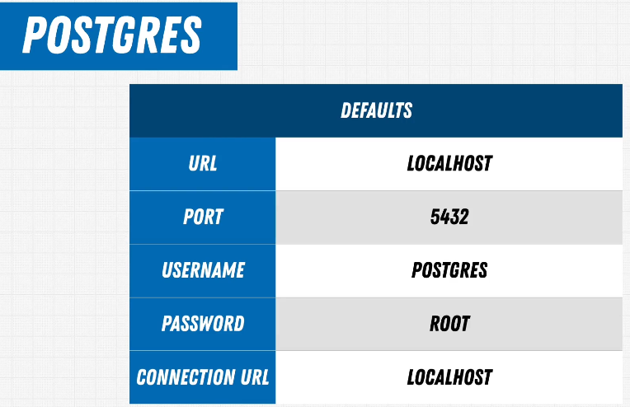

Complete SQL and Database Bootcamp: Zero to Mastery
Databases and SQL Fundamentals
Section: 4.39, 4.40
Date: 13/01/22
Going to be using PostgreSQL and Valentina (GUI) as both are open-source and very popular and you see them in production environment.
The querying is done with SQL in Valentina and communicates with PostgreSQL.
Note that we will have a URL associated with postgres on our machines because it runs as a server. In this case we’ll use localhost. We’re going to setup postgres with the details down at the bottom right.
PostgreSQL
Valentina-DB

Slide 19
Complete SQL and Database Bootcamp: Zero to Mastery
Section 5
SQL Deep Dive

Slide 20
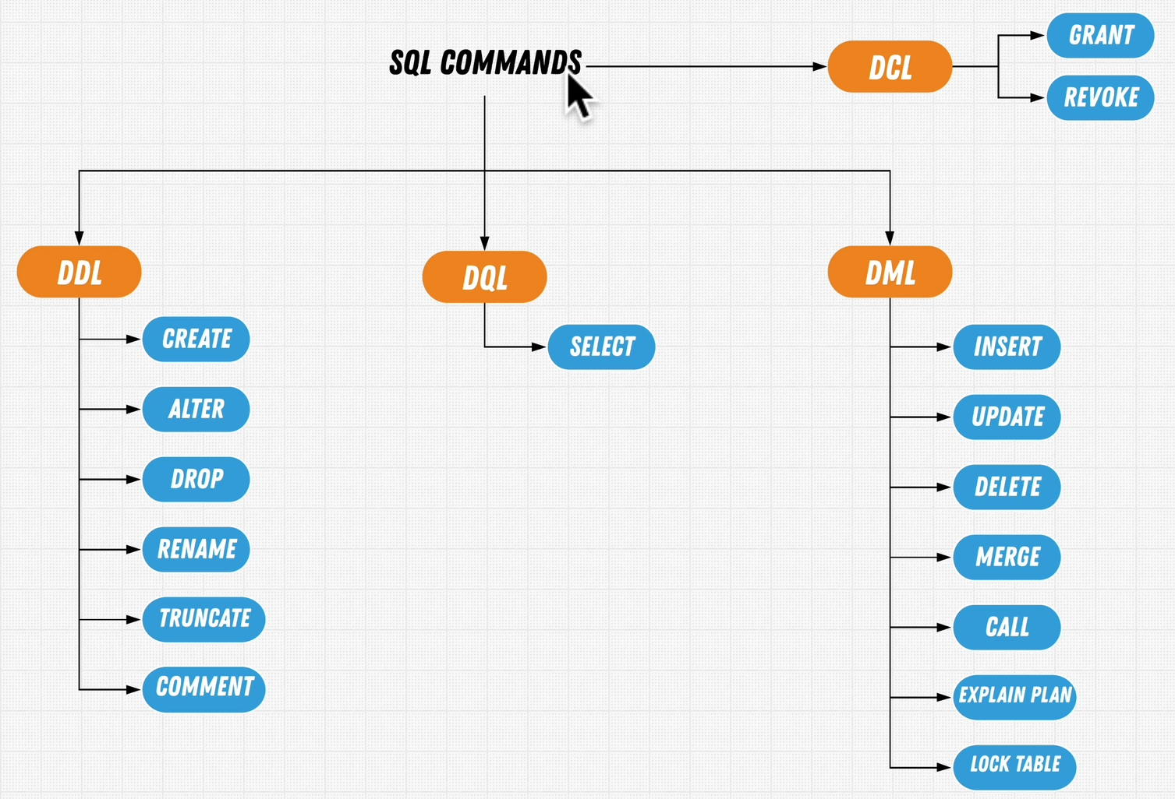
Complete SQL and Database Bootcamp: Zero to Mastery
SQL Deep Dive
Section: 5.53
Date: 15/01/22
Data Control Language
(granting and revoking access for different users)
Data Definition Language
(used for setting up the database, concerned with the removal and addition of data)
Data Modification Language
(used to manipulate data already there in the database)
Data Query Language
(focus on this heavily, once we have the database, the main thing we’re going to do is find and retrieve this data.)

Slide 21
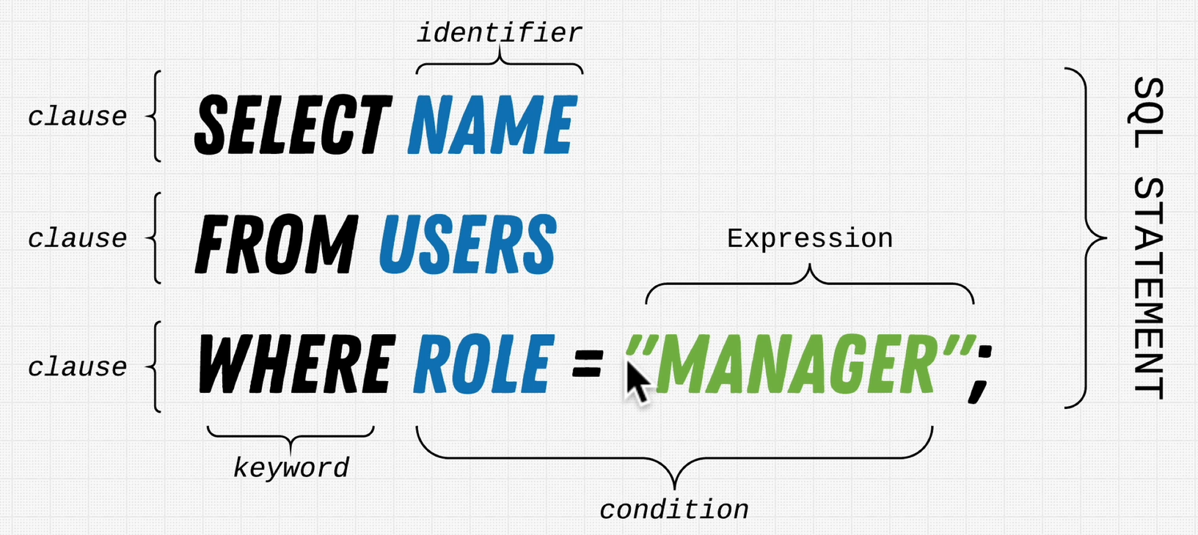
Complete SQL and Database Bootcamp: Zero to Mastery
SQL Deep Dive
Section: 5.53
Date: 15/01/22
SELECT command

Slide 22
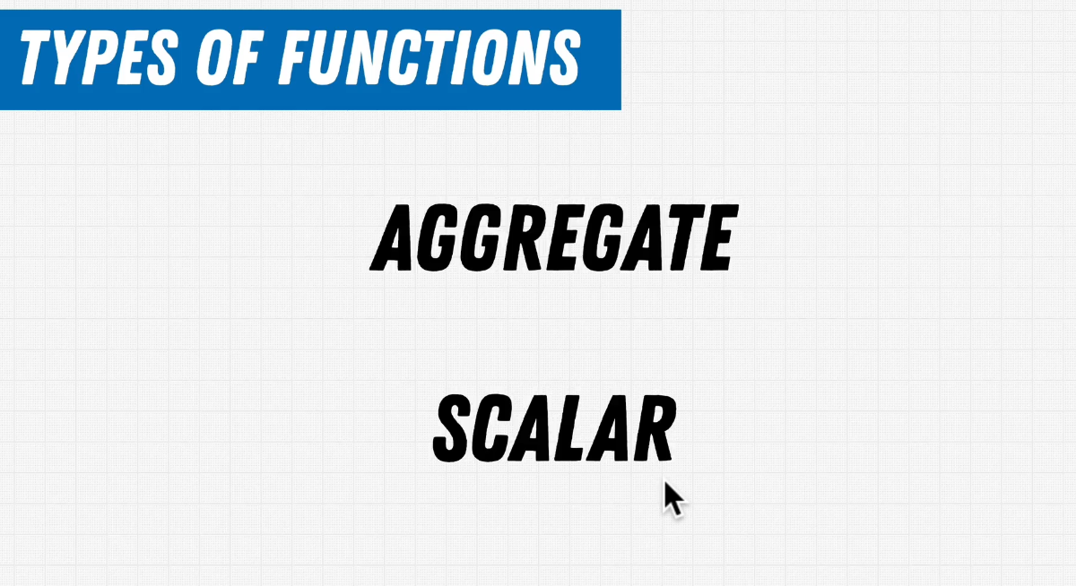


Complete SQL and Database Bootcamp: Zero to Mastery
SQL Deep Dive
Section: 5.57
Date: 15/01/22
Aggregated the data and produces a single value e.g. a sum of a column, average of a column etc.
Run against each individual row, for example concat.
If we run a scalar average we’ll get an average of specified columns for each row.

Slide 23

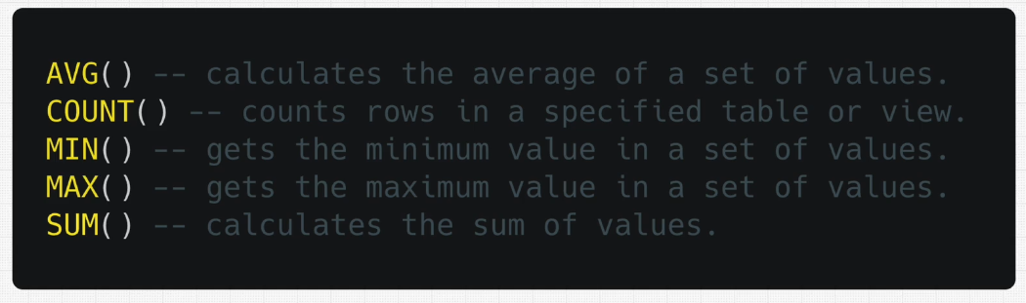
Complete SQL and Database Bootcamp: Zero to Mastery
SQL Deep Dive
Section: 5.58
Date: 15/01/22

Slide 24
Complete SQL and Database Bootcamp: Zero to Mastery
Section 6
Advanced SQL

Slide 25
Complete SQL and Database Bootcamp: Zero to Mastery
Section 7
Database Management

Slide 26
Complete SQL and Database Bootcamp: Zero to Mastery
Section 8
Solving the Mystery

Slide 27
Complete SQL and Database Bootcamp: Zero to Mastery
Section 9
Database Design

Slide 28
Complete SQL and Database Bootcamp: Zero to Mastery
Section 10
Database Landscape, Performance and Security

